Slide 1
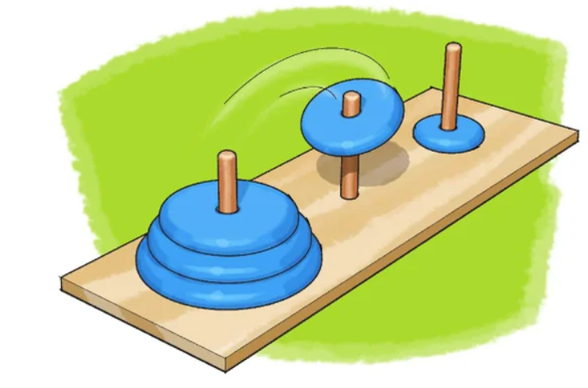
Interactive Tower of Haonoi

Slide 2
History
There is a story about an Indian temple in Kashi Vishwanath which contains a large room with three time-worn posts in it, surrounded by 64 golden disks. Brahmin priests, acting out the command of an ancient prophecy, have been moving these disks in accordance with the immutable rules of Brahma since that time. The puzzle is therefore also known as the Tower of Brahma puzzle. According to the legend, when the last move of the puzzle is completed, the world will end.^{[3]}
If the legend were true, and if the priests were able to move disks at a rate of one per second, using the smallest number of moves it would take them 2⁶⁴ − 1 seconds or roughly 585 billion years to finish,^{[4]} which is about 42 times the current age of the Universe.

Slide 3
What is Tower of Hanoi ?
Is a mathematical game or puzzle. It consists of three rods and a number of disks of different sizes, which can slide onto any rod. The puzzle starts with the disks in a neat stack in ascending order of size on one rod, the smallest at the top, thus making a conical shape.
The objective of the puzzle is to move the entire stack to another rod,
obeying the following simple rules:
Only one disk can be moved at a time.
Each move consists of taking the upper disk from one of the stacks and placing it on top of another stack or on an empty rod.
No larger disk may be placed on top of a smaller disk.

Slide 4


Slide 5
Method Prototype | Arguments | Return type | Description
void intro(); | No arguemenst | Void | Initialize game in command line.
void printLine(); | No arguemenst | Void
void startingScreen() | No arguemenst | Void | maximize the screen automatically
bool machineSolve(int &disks); | Reference to int | boolean | When machine solve return raise a flag.
void userSolve(int&); | Reference to int | void
void fromAToB(StackLinked<int>&,StackLinked<int>&); void fromAToC(StackLinked<int>&,StackLinked<int>&); void fromBToC(StackLinked<int>&,StackLinked<int>&); | Two References to template StackLinked object of type (int) | void
bool checkEmpty(StackLinked<int>&,StackLinked<int>&); | Two References to template StackLinked object of type (int)
bool checkMove(StackLinked<int>&,StackLinked<int>&); | Two References to template StackLinked object of type (int)

